Slide 1


CASHCOW
PORTFOLIO PRESENTATION

Slide 2
01
BACKGROUND
03
PROJECT
MANAGEMENT APPROACH
Overview of the Multi-Project Management Exercise (MPME) and its objectives. Why managing multiple projects effectively is critical in real-world scenarios.
The strategies used by individual Project Managers to execute their tasks. Key challenges faced at the project level and how they were addressed.
PRESENTATION
OVERVIEW
02
PORTFOLIO
MANAGEMENT APPROACH
04
EVALUATION
How the Portfolio Team coordinated multiple projects. Decision-making, resource allocation, and team communication strategies.
Reflection on successes and areas for improvement. Insights gained from the simulation that can be applied to real-world multi-project environments.

Slide 3
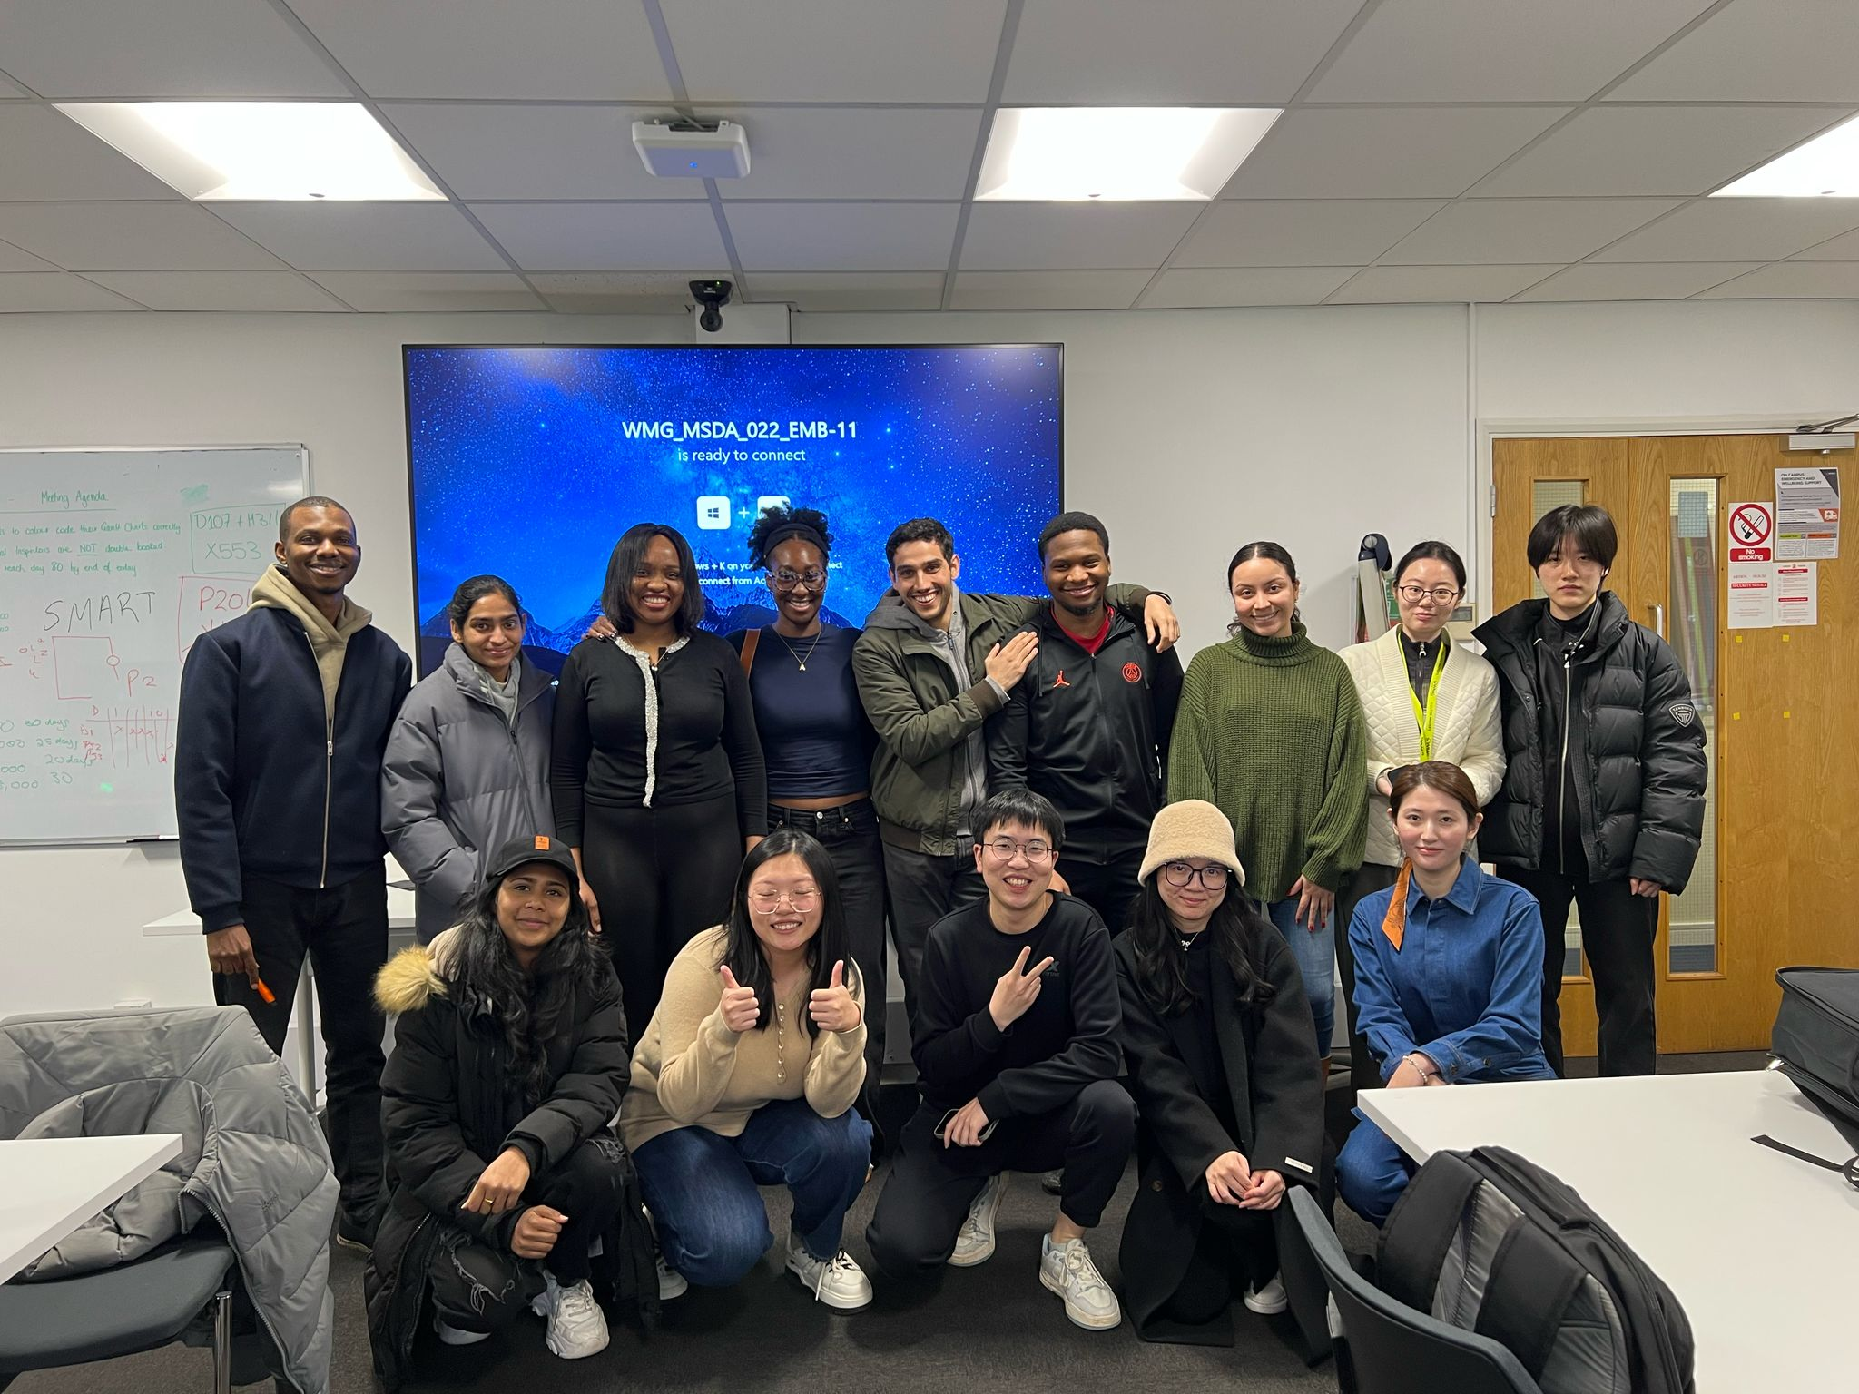
OUR TEAM

Slide 4
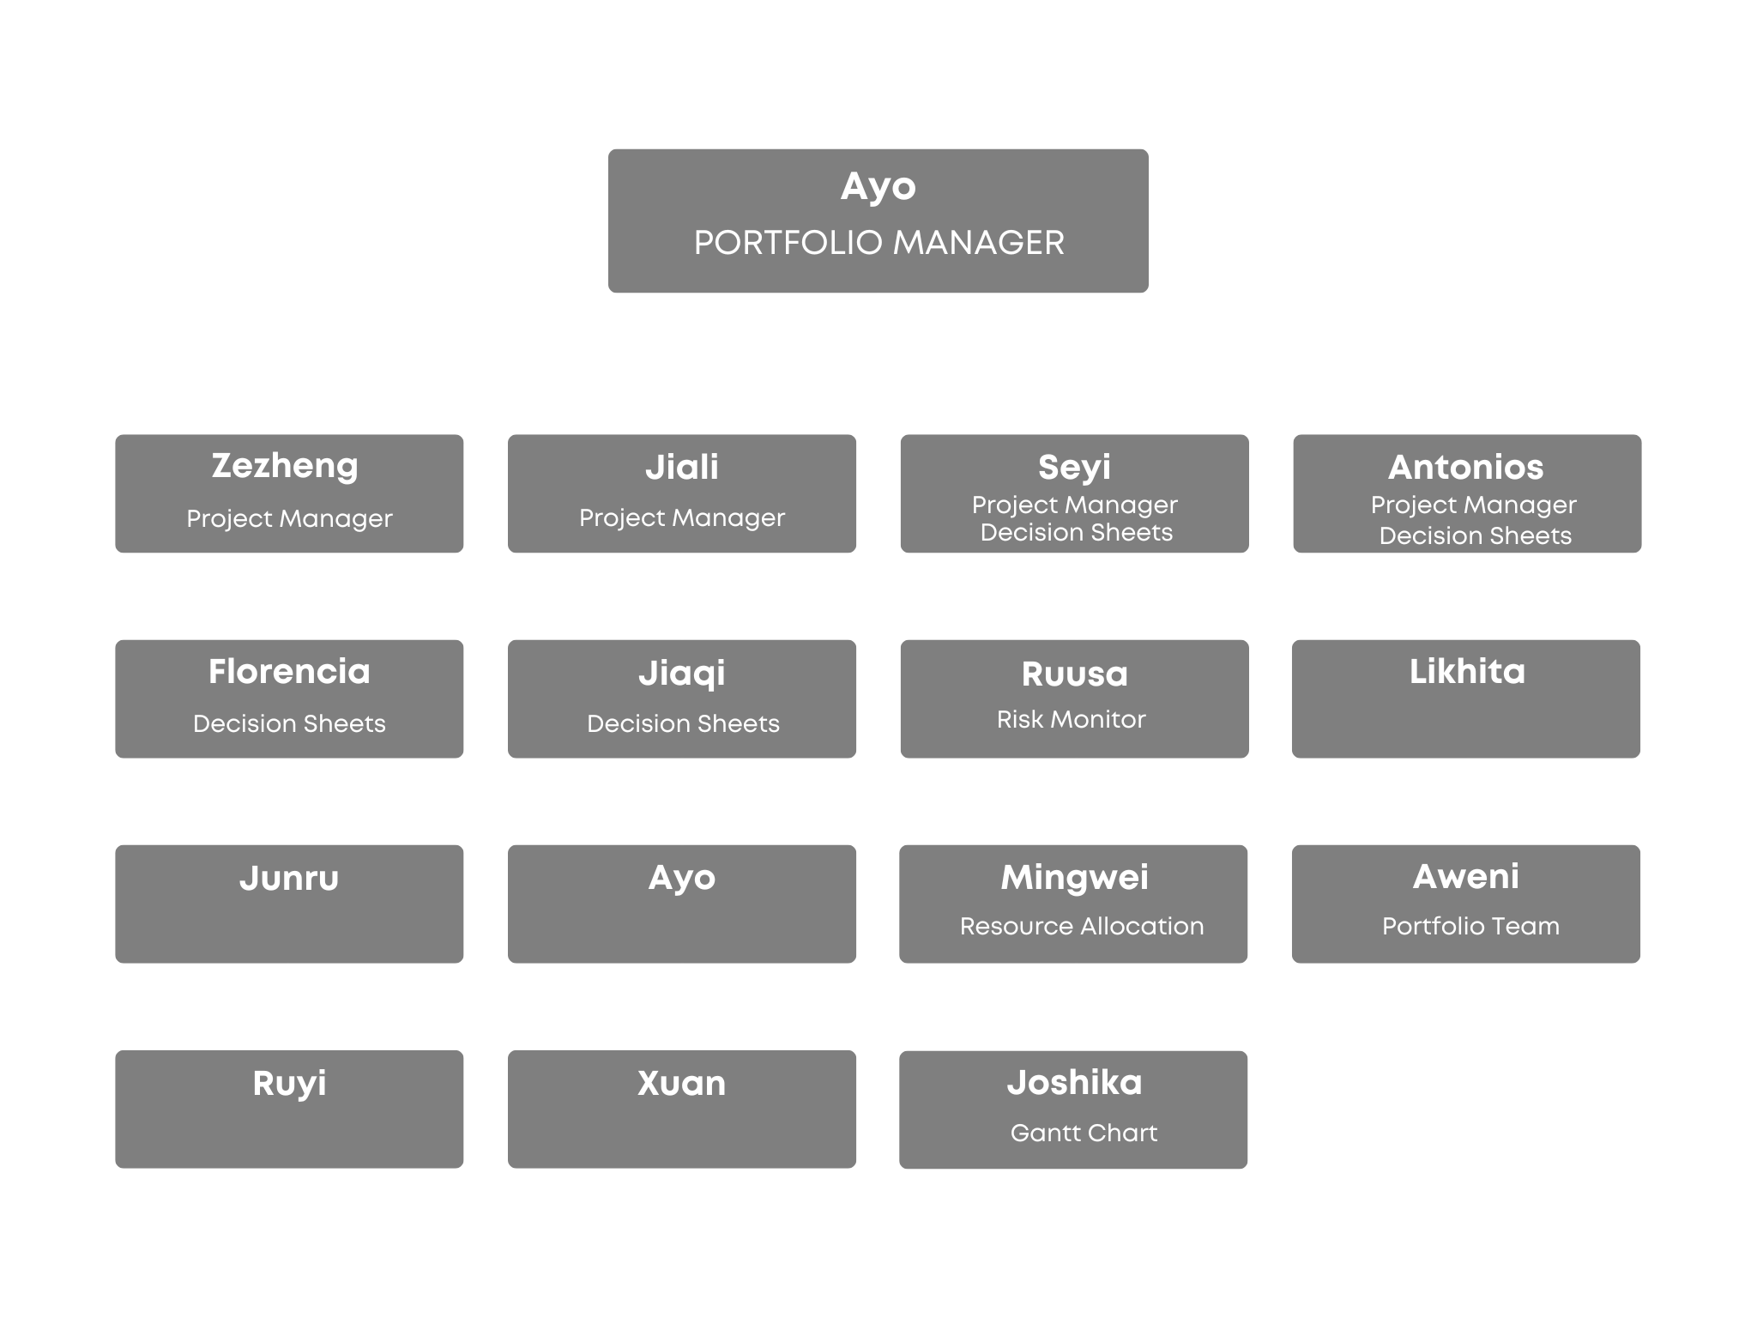
ORGANISATIONAL STRUCTURE

Slide 5



Balanced Profitability & Flexibility
We strategically selected one high-earning project to maximize revenue while also choosing one project with flexible deadlines to allow room for adjustments. This ensured a mix of financial stability and adaptability in managing resources and timelines.
Optimised Resource Allocation
By selecting projects with different time constraints, we could distribute resources efficiently across the portfolio. This reduced bottlenecks and allowed us to prioritise workload based on urgency and potential risks.
Cross Project Integration
By selecting projects with different time constraints, we could create opportunities for knowledge sharing & collaboration reducing the risk of widespread project failure. This also allowed portfolio team to have better resources planning for other projects

Slide 6


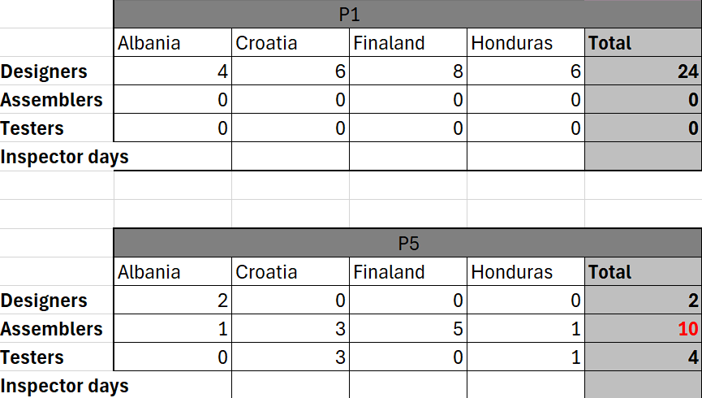

TIMELINE
Project Selection & Strategy
Chose a high-earning project and a time-flexible project to balance profitability and adaptability.
Developed a resource allocation plan based on project needs and constraints.
Communication Approach: From the start, we adopted a democratic decision-making style, ensuring all voices were heard in selecting projects.
Resource Scheduling heuristics: Most Resources First
Execution & Challenges
Faced resource bottlenecks and scheduling conflicts across projects.
Managed unexpected delays and cost variations, adjusting strategy as needed.
Communication Approach Amended: Encouraged open dialogue within the team, allowing everyone to contribute to problem-solving but ensured

Slide 7


Adjustments & Optimization
Are we on track and how much intervention is needed?
Reallocated resources dynamically to meet deadlines and minimize penalties.
Improved communication & decision-making across the teams.
Setting out future objectives and strategies
for achieving them
Our focus moving forward is on optimizing resource allocation, strengthening decision-making processes, and applying key learnings to improve efficiency. By continuously refining our approach, we aim to enhance project success and mitigate risks."
Reflection & Key Learnings
Analyzed what worked well and what could be improved.
Identified strategies for better risk management and efficiency in future projects.
Review the initial plan. What assumptions did we make

Slide 8
PORTFOLIO RISK STRATEGY
1
TIME
QUALITY
FINLAND
COST
2
CROATIA
TIME
QUALITY
Strategic diversification of risk across projects with varied contract values and durations.
Balance of high risk and low risk contracts.
Prioritisation of projects depending on their durations and cost of penalties.
Based on contract values, individual projects were able to determine their own triple constraint objectives.
Consistent scheduling across project in the planning phase to allow for 'worst-case scenario'.
Aimed for top two projects to be risk averse to minimise time overruns.
COST
3
COST
QUALITY
HONDURAS
TIME
4
COST
QUALITY
ALBANIA
TIME

Slide 9
PORTOLIO RISK MATRIX
Project | Risk | As a result of… (CAUSE) | Uncertain event may occur… (RISK) | Which would lead to effect on objective(s) (IMPACT) | Probability (L/M/H) | Mitigation Strategy | Contingency Plan
CASH COW PORTFOLIO | Missed inspection days for lower priority projects. | Only one inspector is available for the overall portfolio within each period. | These inspection days would need to be booked in a later period, potentially leading to time overruns and project delay. | Inspections on the critical and sub-critical paths will be delayed by up to 20 days. | HIGH | Try to rearrange inspection days across projects to run sequentially to avoid clashes. Use float to our advantage. | Recruit an additional inspector in the busiest period 5 to minimise the risk of time delays for projects.
 | Lower priority projects receive less resources in the initial periods increasing the probability of delay risks on the critical path. | Misallocation of internal resources to each project based on overall portfolio strategy. | Overall projects will be delayed leading to a failure to meet portfolio objectives. | Project delays will result in penalties per extra day reducing the overall portfolio profit. | MEDIUM | Clear communication between project teams and portfolio team to identify minimum resources required to complete project on-time. | Maximise resources in the final periods to reduce the durations of finals tasks for lower priority projects.
 | Task delay and resource conflict | Fixed resource and potential task overruns | Α task may be delayed and not completed within the planned period | Resource conflict in the following period, affecting other projects | MEDIUM | Calculate all task durations based on the maximum potential time | Prioritise the most critical project and recruit additional resources for the next period to cover the gap caused.
 | Inefficient communication between projects leading to conflicts or reduced engagement. | Poor establishment of communication channels and lack of clear leadership roles. | Conflicts between team members and lack of clear decision-making leading to poor project performance. | Potentially poor project decision-making leading to project failures such as delays and losses. | LOW | Establish a clear portfolio organisation structure and assign each member a role to encourage delegation of tasks. | Allow room in the budget at the portfolio level to rectify any poor project decisions or mistakes.

Slide 10
FINLAND RISK MATRIX
Project | Risk No. | As a result of… (CAUSE) | Uncertain event may occur… (RISK) | Which would lead to effect on objective(s) (IMPACT) | Probability (L/M/H) | Impact on T/C/Q/ in days and/or £ | Mitigation Strategy | Contingency Plan
Finland | M311 | Extension of D107's estimated man-days and design job not being completed within planned time frame. | M311 may be delayed resulting in the duration of M311 being pushed into later periods 5/6 and minimising the amount of time left for A720 and T522. | Missed inspection for I016 - this would need to be rebooked one period in advance resulting in reduced time on the critical path for later jobs. | High | Time - could result in our project finishing 10+ days later. Cost - £10,000 per day for overrunning | Subcontract D107 and reassign all internal designers to the sub-critical path. | Account for extra resources that may need to be distributed to assembly and test jobs on the critical path in periods 5-7 to reduce the duration of tasks.
 | D108 | Extension of D108's estimated man-days and design job not being completed within planned time frame. | M312 will commence later, thus pushing the inspection - I017 later. This is significant as T522 on the critical path is dependent on I017 being completed on time | Delayed inspection and delayed start to T522 on the critical path which could result in the overall project running over schedule. | Medium | Time - Additional time spent on this design job and an extra £400/day on a designer in the next period as a contingency. Cost - £10,000 per day for overrunning | Choose a manufacturer that will complete M312 in the least amount of time and ensure that there is float after M312 to minimise the impact of this job overrunning. | Booking additional designers in the subsequent period to ensure that D108 is completed and does not impact the start of the M312.
 | I019 | Missed inspection day or failed inspection due to M315 overrunning or low quality. This is a significant risk as this job falls on the sub-critical path. | I019 will be missed or need to be repeated and will need to be rebooked for the next period resulting in up to 20 days lost. This will delay the start of A721. | Delayed start to A721 in the later periods will affect T523 and subsequently A724 on the critical path which could result in the overall project overrunning. | Medium | Time - Additional time spent on this manufacturing job which could lead to the project overrunning. Cost - £1500/day sunk costs for the inspectors booked and additional £1500/day for the next period. | Choose a manufacturer with a reliable history and record of high quality to reduce the risk of failed inspection or the job overrunning. | Book sufficient assemblers and testers in period 6 to reduce the durations of A721 and T523 in period 6 to limit the impact of M315 overrunning and the critical path being extended.
 | T530 | Test failure due to poor assembly of A729. | Both A729 and T530 would need to be redone in the next period. | Could delay the start of A721 and subsequently delay tasks on the critical path. | Medium | Time - A whole period is used to repeat the assembly and test jobs. Possible delay impact on A721 being completed on time. Cost - Additional £1,100/day in period 5 as a contingency. Potential £10,000/day if jobs on the critical path are delayed. | Assign sufficient assemblers and testers in period 4 to ensure that these jobs are completed within one period. This ensures that if the jobs need to be repeated, float can be used in period 5. | Book at least one additional assembler and tester in period 5 to reduce the delay of A721 starting later.

Slide 11
CROATIA RISK MATRIX
Project | Risk No. | As a result of… (CAUSE) | Uncertain event may occur… (RISK) | Which would lead to effect on objective(s) (IMPACT) | Probability (L/M/H) | Impact on T/C/Q/ in days and/or £ | Mitigation Strategy | Contingency Plan
Croatia | P204 (A) | Quality of the selected purchaser (Y163) | Supplier failure and task P204 will be delayed | Inspection I013 will be delayed | High | Cost - £4,500 for 3 missed inspection days | Select a more reputable supplier | Allow for space in the budget to rebook inspection days and choose a more expensive supplier.
 | I028 | I028 not commencing in period 2 as planned (Oversight) | Inspection days not captured in decision sheet were missed | Delay in commencement of Task A729 | Medium | Cost - £4,500.00 for 3 missed inspection days | Review decision sheets appropriately and pay attention to details | Book extra inspection days in period 3 and ensure that decision sheets are appropriately reviewed by the team before submission.
 | P204 (B) | Quality of the selected purchaser (Y465) | Supplier failed and Task P204 was delayed | Inspection I013 will be delayed | Medium | Cost - £4,500.00 for 3 missed inspection days | Select the highest quality supplier | Select a more reputable supplier Y364 AT Day 70
 | A729 | A729 not commencing in Period 3 (Oversight) | A729 was not captured in the decision sheet | Delay in commencement of task A729 and T530 | Medium | Cost - £10,000.00 for 3 assemblers in period 3 that were wasted | Review decision sheets appropriately and pay attention to bookings on decision sheets | Book extra assemblers to finish the task faster in period 4
 | T530 | Test Failure | Initial Test Failure and repeat of the assembly task A729 | Delay in commencement of Task A721 which is on the critical path | High | Sunk Cost of initial assembly work on A721 | Extra Assemblers booked to work on A729 in subsequent period | Additional testers and assemblers booked in advance for the next period

Slide 12
ALBANIA RISK MATRIX
Project | Risk No. | As a result of… (CAUSE) | Uncertain event may occur… (RISK) | Which would lead to effect on objective(s) (IMPACT) | Probability (L/M/H) | Impact on T/C/Q/ in days and/or £ | Mitigation Strategy | Contingency Plan
Albania | D108 | Extension of D108's estimated man-days. | Other design jobs, D105 and D109, not being completed within planned time frame. | M312 will delay and T522 on the critical path will be influenced. | Medium | Time-20 days delay for the completion of all design jobs Cost- Extra 3 designers (£24000) in period 5 and 6 for D105 and D109. | Start job task earlier with sufficient designer resources in period 3. | Set as the priority design job in period 4 and select the most reputable subcontractor with shorter durations in case of failure and delays.
 | D109 | Extension of D109's estimated man-days and insufficient designers in period 6. | M315 cannot commence. | The whole project's progress will be delayed. | High | Time-10 days delay of commencing M315 Cost-Extra 1 designer in period 6 (£8000) and extra assembles and testers in later 2 periods to ensure the delivery date | Book an extra designer in period 6. | Select the most reputable subcontractor for M315 and maximize the assemblers and testers in period 7 and 8.
 | I028 | Time conflicts for the inspections | A729 may not finished in period 2 and the need of extra assemblers in the next period. | Delay of T530 | Medium | Cost- Extra 1 assembler(£10000) in period 2 | Select the first few days to do the inspection in period 2. | Book extra assemblers to ensure the A729 completed in period 2.
 | T530 | Test failure | Both A729 and T530 will have to be redone in the next period. | A721 will not be able to start on time. | High | Cost- Extra 1 assembler(£10000) and 1 Tester(£12000) for restarting the A729 and T530 | Book 1 extra assembler in period 5 and 1 tester in period 6. | Book 2 extra assemblers and 2 testers in period 6 in case of the failure and its impact on A721.
 | T523 | Extension of A729's and T523's estimated man-days | Delay of Inspection I026. | Delayed delivery date | Medium | Time- Resulted in the 10 days delay of the delivery date Cost- The cost of extra assemblers and testers out of planning and the penalty of 10 days ( £75,000) delay of delivery time | Book the maximum assemblers and testers in period 8. | Book the extra inspection days in case of delay.

Slide 13
HONDURAS RISK MATRIX
Project | Risk No. | As a result of… (CAUSE) | Uncertain event may occur… (RISK) | Which would lead to effect on objective(s) (IMPACT) | Probability (L/M/H) | Impact on T/C/Q/ in days and/or £ | Mitigation Strategy | Contingency Plan
Honduras | M311 | Motivated by cost savings, supplier X251 was chosen, which offered low prices but variable quality that could be excellent. | X251 withdrew midway due to quality qualification issues, causing a serious delay in the progress of M311. | All tasks on the critical path were delayed, resulting in a significant of not finishing in 140 days. | High | Time - M311 was completed only around 140 days later. This inevitably led to delays in the entire project. Cost - Penalties of £8,000 for each day of delay. | Re-select the supplier with a high quality even though more expensive | Allocate as many resources as possible in periods 7 and 8 to finish the project on time, as this delay affected the critical path directly.
 | D108 | The expected completion time for D108 was revised to be longer than originally scheduled. | M312 will start later, and so will I017, which delay T522 on the critical path. | The delayed start of T522 is likely to cause a delay in the delivery of the entire project. | Medium | Cost - If the extension is carried over to the next period, more designers will have to be allocated, at £400 per person per day. | Select a subcontractor that can guarantee the speed and quality of delivery for M312 to reduce the overall risk of delay | Book additional designers to ensure the completion of D108.
 | P214 | Selection of the risky Y466 supplier after price and quality factors. | The selected supplier withdrew midway causing the task to fail. | Selection of a new supplier and would make I018 delay. | Medium | Cost - £3,000 for 2 inspection days | Select the most expensive but more reliable supplier | Re-select Y567 as a contingency plan.
 | T530 | Task failure | Have to re-start both A729 and T530 | A721 will start later, leading to an overall delay risk. | Medium | Cost -All manpower related to A721 and T530 need to rebooked, causing additional costs. | Allocate sufficient assemblers and testers at an early period to prevent failures when no one is available. | Consider the possibility of the test failure and book the necessary additional resources in advance

Slide 14


Slide 15


PROJECT 1
Finland
Contract:
Value: £1.1m
Lead Time: 130 days
Penalties: £10k/day
Slow execution
Below Budget
Faster completion
Lower cost completion
Performance:
Completion: 129 days
Total spend: £830, 346.63
Penalties: £0
Final profit: £269.653.37
Faster task completion
Progress exceeds expectations

Slide 16
PROJECT 1 FINLAND
SUCCESSES
High-quality resource selection
Maximum time estimation for scheduling in the initial stages of the project.
Adaptability when faced with project set-backs.
Efficient communication between members
Contingencies for job tasks (i.e., booking extra resources in later periods in case of delay)
CHALLENGES
Slow initial progress
Coordinating multiple teams
Balancing project needs with portfolio goals
LESSONS LEARNED
The importance of communication
The importance of collaboration

Slide 17


Slide 18

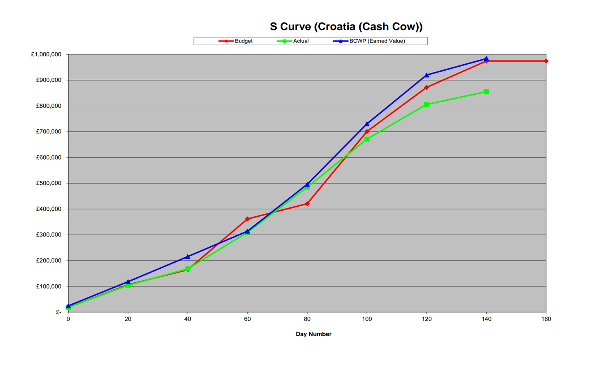
PROJECT 2
Croatia
Contract
Value: £1.05m
Lead Time: 140 days
Penalties: £10k/day
Missed Inspection I028 (Period 2)
Performance:
Completion: 140 Days
Total spend: £855,553.08
Penalties payment: 0
Final profit: £194,446.92
More resources (Assemblers and Testers) and selection of more dependable Suppliers/Manufacturers

Slide 19
PROJECT 2 CROATIA
SUCCESSES
Proper Task Delegation (Risk, Gantt Chart, Supplier/Manufacturer Review, Decision Sheets)
Effective Communication (Formal and informal channels, Frequency and Feedback)
Experience from the PPMC allowed for optimal decision making (Buffers and Resource Allocation)
Lessons Learned and Documents from the PPMC Exercise
Flexible Plans and adequate change approval process within the Project Team
Excellent Soft Skills
CHALLENGES
Cross-project communication at the initiation and planning stage
Language Barriers
LESSONS LEARNED
Document & Apply Lessons Learned to improve future projects.
Identify Risks Early to prevent future issues.
Constant Communication boosts team performance.
Centralized Portfolio Team increases individual project success.
Strength-Based Task Allocation enhances efficiency.
Make Data-Driven Decisions—avoid assumptions.

Slide 20


Slide 21

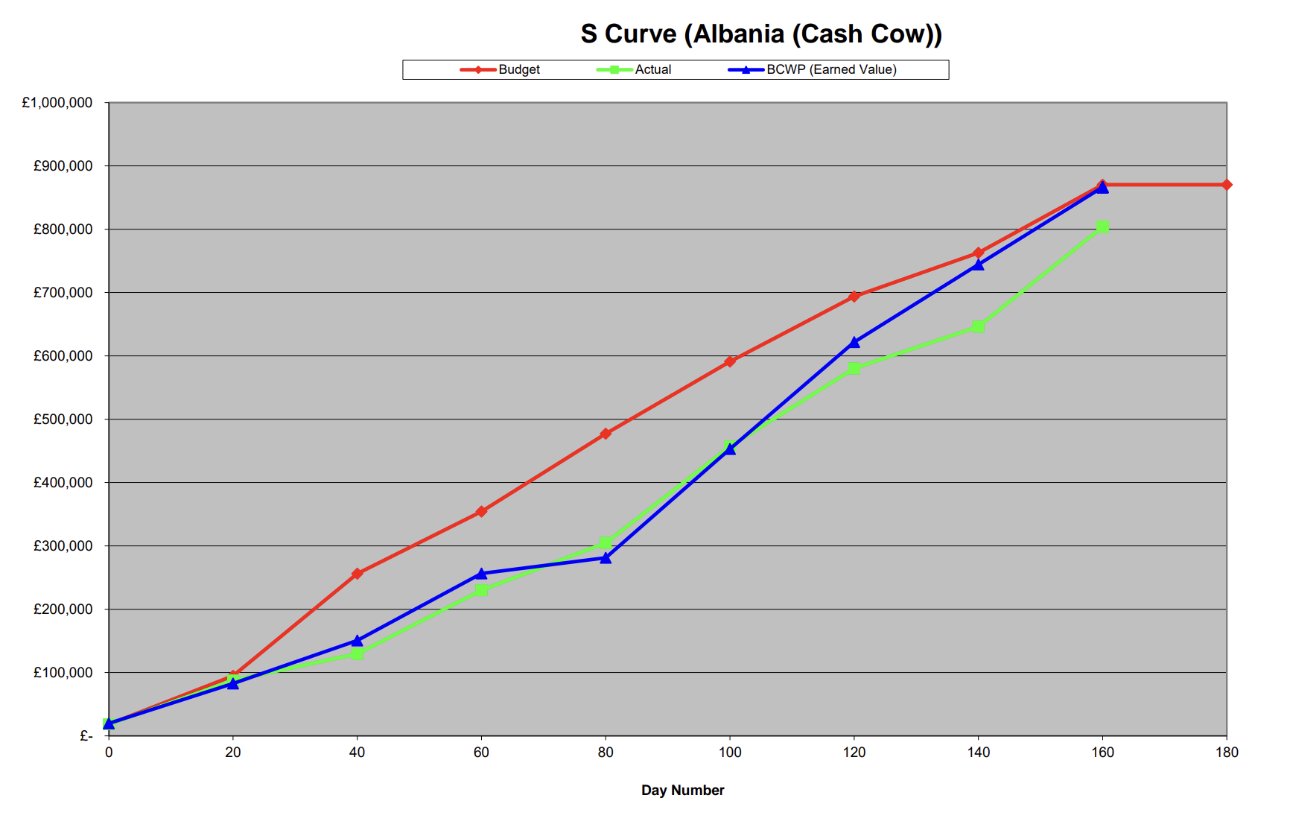
PROJECT 3
Albania
Contract
Value: £900k
Lead Time: 150 Days
Penalties: £7,500/ Day
Slow progress in early periods because of limited resources (designers)
Speed up the progress by allocating more resources and choosing more reputable but more expensive subcontractors
Performance:
Completion: 160 Days
Total spend: £803,647.79
Penalties payment: £75, 000
Final profit: £21, 352.21
Budget control
Not using too much designers

Slide 22
PROJECT 3 ALBANIA
SUCCESSES
Budget controlling
e.g. not exceeding the human resources at the level of band B or
trying to allocate the assembler work and test task in one period)
High-quality subcontractors and suppliers selection
( trade money for time)
Mitigation plan according to previous experiences
( extra resources for task failure and extension in case of the time
delay)
Good teamworking
CHALLENGES
Limited resource allocation as the project was low priority in the portfolio.
Extension beyond expectation
LESSONS LEARNED
Initial strategy for portfolio management
Sufficient communication between project teams
Mitigation plan and contingency plan

Slide 23


Slide 24
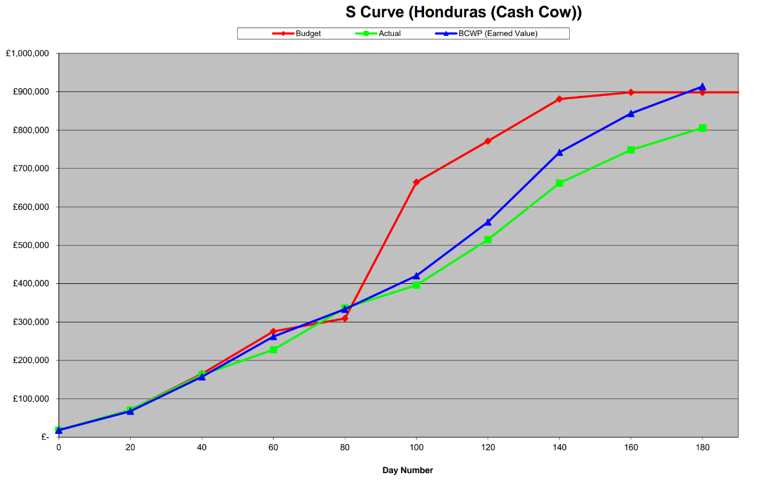

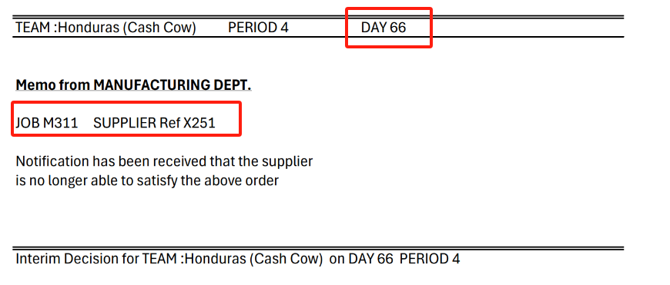
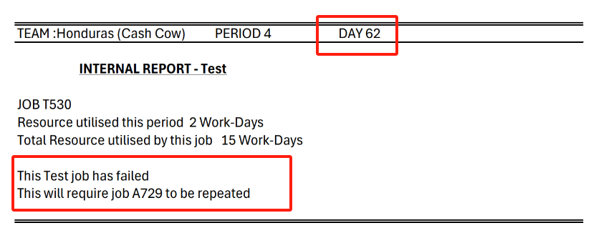
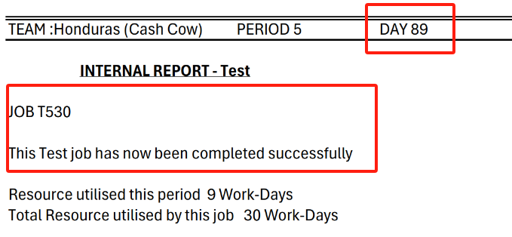

PROJECT 4
Honduras
Contract
Value: £1.05m
Lead Time: 140 Days
Penalties: £8,000/ Day
Performance:
Completion： 171 Days
Total Spend: £805,754.32
Penalties Payment: £248,000
Final Profit: -£3,754.32

Slide 25
PROJECT 4 HONDURAS
SUCCESSES
Acceptable Overall Cost Control
Reasonable Arrangement of Inspectors
Effective Ways of Mitigating the Risk of Test Failure
CHALLENGES
More Comprehensive Risk Control of Supplier Selection
LESSONS LEARNED
Good Internal Teamwork
Effective and Efficient Negotiating Skills.
The Project Manager's Role as a BRIDGE

Slide 26

KEY TAKEAWAYS
Resource Management: ​
Simulation --> The first three stages were done well, as can be seen from the total spend and curve.​
Real life --> Consider personnel flow from a more detailed perspective.​
Resource Management
Communication: ​
Simulation --> Manager as a bridge with other teams and portfolio.​
Real life -->Cross-departmental collaboration.
Communication
Organisational Structure:
Simulation --> Lack of clear task division.
Real life --> Established processes.
Decision - making
Organisational Structure
Decision-making:
Simulation --> Better analysis needed when selecting suppliers (M311 & P214).
Real life --> Conduct market research taking into account the country, region, and company culture.

Slide 27

PORTFOLIO PROFIT
PORTOLIO CONTRACT
£481,698
TOTAL
SPEND
£3,618,302
£4,100,00
PORTFOLIO RESULTS
£ 269,653
£ 194,446.92
£ 21,352.21
£-3,754.32
£ 830,346.63
£ 855,553.08
£ 878,647.79
£1,053,754.32
£ 1,100,000
£ 1,050,000
£ 900,000
£1,050,000

Slide 28
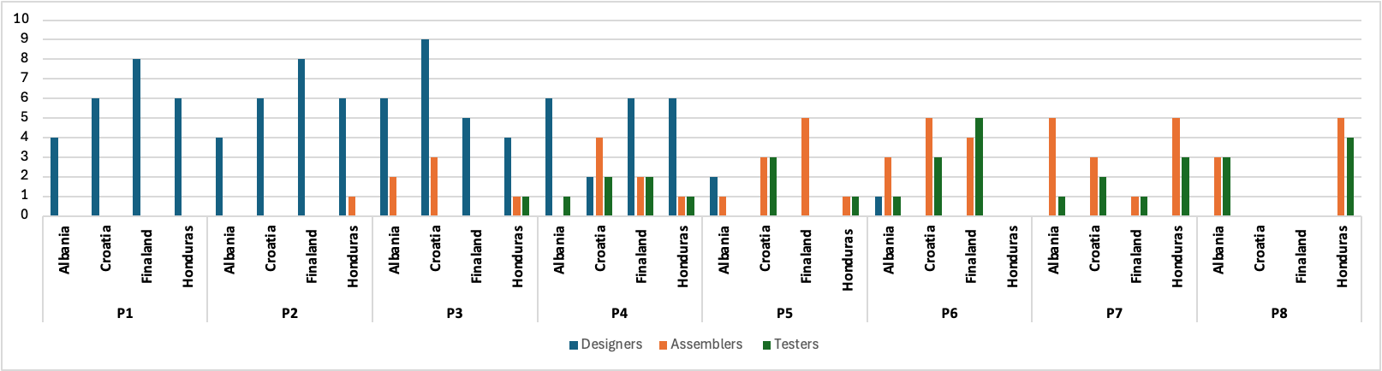
PORTFOLIO RESOURCE ANALYSIS

Slide 29
PORTFOLIO KEY TAKEAWAYS

Slide 30
Good prioritisation of projects at the portfolio level, however lack of consideration for resource allocation to lower priority projects (i.e. Albania).
Inconsistent choice of suppliers and manufacturers across all projects – maintain consistency for future projects.
Clear communication plans and emphasis on collaboration is essential to project performance.
S
W
Clear governance framework.
Detailed risk management identification and mitigation plans.
Clear portfolio strategy and objectives established early on.
Misalignment between project leaders – narrow view of portfolio.
Lower priority projects underperformed
Project overlaps, limiting availability of resources.
Strengths
Weaknesses
O
T
Reallocation of unused resources from other projects
Learning from past periods mistakes to optimize future decision-making
Unforeseen changes by external suppliers and manufacturers.
Conflicts between team members over decisions.
Opportunities
Threats

Slide 31
THANK YOU FOR LISTENING
We welcome any questions.

